Slide 1
Artificial intelligence
Session – 8
Date – 05th June, 2022

Slide 2
OpenCV Image Filters
Image filtering is the process of modifying an image by changing its shades or color of the pixel. It is also used to increase brightness and contrast. In this tutorial, we will learn about several types of filters.

Slide 3
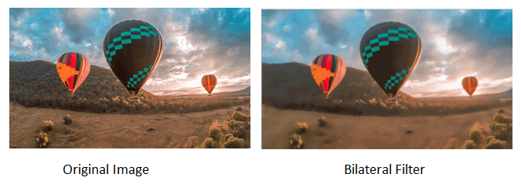
Bilateral Filter
OpenCV provides the bilateralFilter() function to apply the bilateral filter on the image. The bilateral filter can reduce unwanted noise very well while keeping edges sharp. The syntax of the function is given below:
cv2.bilateralFilter(src, dst, d, sigmaSpace, borderType)
Parameters:
src- It denotes the source of the image. It can be an 8-bit or floating-point, 1-channel image.
dst- It denotes the destination image of the same size. Its type will be the same as the src image.
d - It denotes the diameter of the pixel neighborhood (integer type) that is used during filtering. If its value is negative, then it is computed from sigmaSpace.
sigmaColor - It denotes the filter sigma in the color space.
sigmaSpace - It denotes the filter sigma in the coordinate space.
We can also say that bilateral filter is a non-linear, edge-preserving and noise-reducing smoothing filter for image.
Consider the following example:
import cv2
import numpy as np
from matplotlib import pyplot as plt
img = cv2.imread(r’path\baloon.jpg',1)
kernel = np.ones((5,5),np.float32)/25
blur = cv2.bilateralFilter(img,9,75,75)
plt.subplot(121),plt.imshow(img),plt.title('Original')
plt.xticks([]), plt.yticks([])
plt.subplot(122),plt.imshow(blur),plt.title('Bilateral Filter')
plt.xticks([]), plt.yticks([])
cv2.imshow("Image",blur)

Slide 4
Box Filter
We can perform this filter using the boxfilter() function. It is similar to the averaging blur operation. The syntax of the function is given below:
cv2. boxfilter(src, dst, ddepth, ksize, anchor, normalize, bordertype)
Parameters:
src - It denotes the source of the image. It can be an 8-bit or floating-point, 1-channel image.
dst- It denotes the destination image of the same size. Its type will be the same as the src image.
ddepth - It denotes the output image depth.
ksize - It blurs the kernel size.
anchor - It denotes the anchor points. By default, its value Point to coordinates (-1,1), which means that the anchor is at kernel center.
normalize - It is the flag, specifying whether the kernel should be normalized or not.
borderType - An integer object represents the type of the border used.

Slide 5
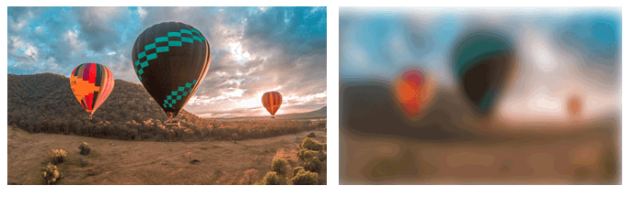
Box Filter
Consider the following example:
import cv2
import numpy as np
# using imread('path') and 0 denotes read as grayscale image
img = cv2.imread(r’path\baloon.jpg',1)
img_1 = cv2.boxFilter(img, 0, (7,7), img, (-1,-1), False, cv2.BORDER_DEFAULT)
#This is using for display the image
cv2.imshow('Image',img_1)
cv2.waitKey(3) # This is necessary to be required so that the image doesn't close immediately.
#It will run continuously until the key press.
cv2.destroyAllWindows()

Slide 6
Filter2D
It combines an image with the kernel or we can convolve the image with the kernel. We can perform this operation on an image using the Filter2D() method. The syntax of the function is given below:
cv2.Filter2D(src, dst, kernel, anchor = (-1,-1))
Parameters:
src - It represents the input image.
dst- It denotes the destination image of the same size. Its type will be the same as the src image.
kernel - It is a convolution kernel, a single-channel floating-point matrix. If you want to apply different kernels to different channels, split the image into a separate color plane using the split () process them individually.
anchor - It denotes the anchor points, by default its value Point(-1,1), which means that the anchor is at kernel center.
borderType - An integer object represents the type of the border used.

Slide 7
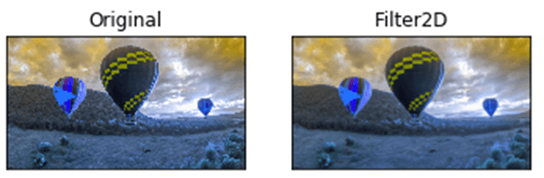
Filter2D
Consider the following example:
import cv2
import numpy as np
from matplotlib import pyplot as plt
img = cv2.imread(r’path/baloon.jpg',1)
kernel = np.ones((5,5),np.float32)/25
dst = cv2.filter2D(img,-1,kernel)
plt.subplot(121),plt.imshow(img),plt.title('Original')
plt.xticks([]), plt.yticks([])
plt.subplot(122),plt.imshow(dst),plt.title('Filter2D')
plt.xticks([]), plt.yticks([])
plt.show()

Slide 8
OpenCV Image Threshold
The basic concept of the threshold is that more simplify the visual data for analysis. When we convert the image into gray-scale, we have to remember that grayscale still has at least 255 values. The threshold is converted everything to white or black, based on the threshold value. Let's assume we want the threshold to be 125(out of 255), then everything that was under the 125 would be converted to 0 or black, and everything above the 125 would be converted to 255, or white. The syntax is as follows:
retval,threshold = cv2.threshold(src, thresh, maxValue, cv2.THRESH_BINARY_INV)
Parameters-
src: Source image, it should be a grayscale image.
thresh: It is used to classify the pixel value.
maxVal: It represents the value to be given if the pixel threshold value.
OpenCV provides different styles of threshold that is used as fourth parameter of the function. These are the following:
cv2.THRESH_BINARY
cv2.THRESH_BINARY_INV
cv2.THRESH_TRUNC
cv2.THRESH_TOZERO
cv2.THRESH_TOZERO_INV

Slide 9
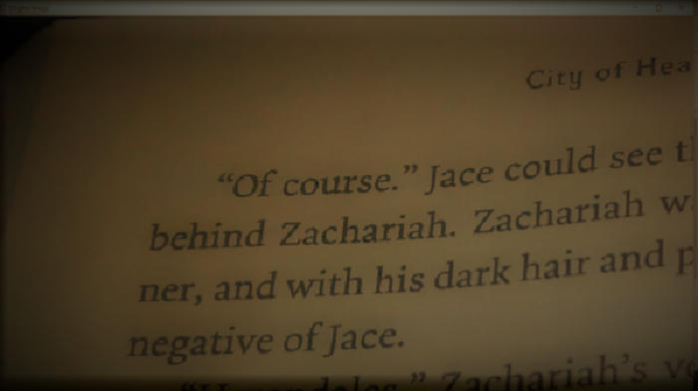
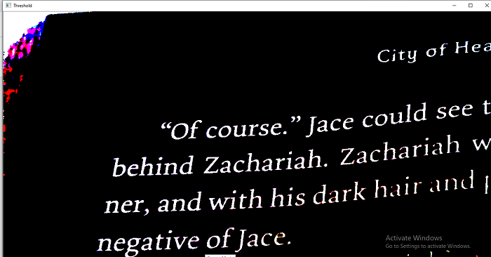
OpenCV Image Threshold
Let's take a sample input image
import cv2
img = cv2.imread(r’path\book1.jpg',1)
retval, threshold = cv2.threshold(img, 62, 255, cv2.THRESH_BINARY)
cv2.imshow("Original Image", img)
cv2.imshow("Threshold",threshold)
cv2.waitKey(0)

Slide 10
OpenCV Template Matching
Template matching is a technique that is used to find the location of template images in a larger image. OpenCV provides the cv2.matchTemplates() function for this purpose. It simply slides the template images over the input image and compares the templates and patch under the input image.
There are various methods available for the comparison; we will discuss a few popular methods in further topics.
It returns a grayscale image, where every pixel represents the number of the neighborhood of that pixel match with the input templates.
Template matching in OpenCV
The templates matching consist of the following step:
Step - 1: Take the actual image and convert it into a grayscale image.
Step - 2: Select the template as a grayscale image.
Step - 3: Find the location where the accuracy level matches. It is done by template image slide over the actual image.
Step - 4: When the result is greater than the accuracy level, mark that position as detected.

Slide 11
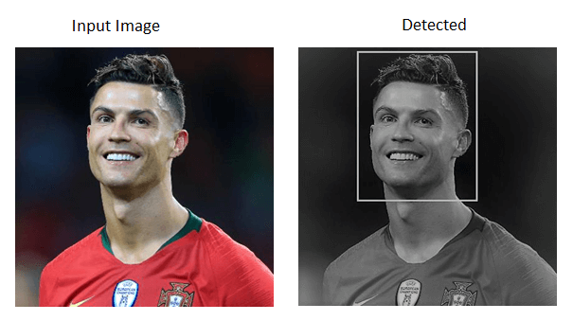
OpenCV Template Matching
Consider the following example:
import cv2
import numpy as np
# Reading the main image
rgb_img = cv2.imread(r’path\rolando.jpg',1)
# It is need to be convert it to grayscale
gray_img = cv2.cvtColor(rgb_img, cv2.COLOR_BGR2GRAY)
# Reading the template image
template = cv2.imread(r’path\ronaldo_face.jpg',0)
# Store width in variable w and height in variable h of template
w, h = template.shape[:2]
# Now we perform match operations.
res = cv2.matchTemplate(gray_img,template,cv2.TM_CCOEFF_NORMED)
# Declare a threshold
threshold = 0.8
# Store the coordinates of matched location in a numpy array
loc = np.where(res >= threshold)
# Draw the rectangle around the matched region.
for pt in zip(*loc[::-1]):
cv2.rectangle(img_rgb, pt, (pt[0] + w, pt[1] + h), (0,255,255), 2)
# Now display the final matched template image
cv2.imshow('Detected',img_rgb)

Slide 12
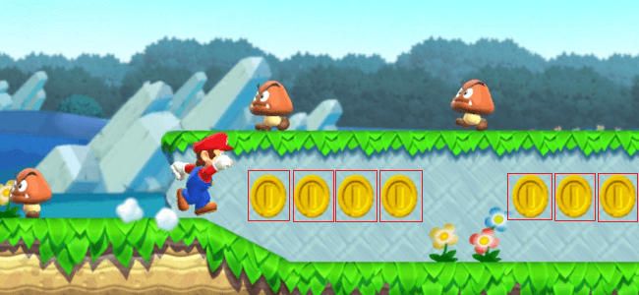
Template Matching with Multiple Objects
In the above example, we searched image for template image that occurred only once in the image. Suppose a particular object that occur multiple times in particular image. In this scenario, we will use the thresholding because cv2.minMaxLoc() won't give all location of template image. Consider the following example.
import cv2
import numpy as np
# Reading the main image
img_rgb = cv2.imread(r’path\mario.png',1)
# It is need to be convert it to grayscale
img_gray = cv2.cvtColor(img_rgb, cv2.COLOR_BGR2GRAY)
# Read the template
template = cv2.imread(r’path\coin1.png',0)
# Store width in variable w and height in variable h of template
w, h = template.shape[:2]
# Now we perform match operations.
res = cv2.matchTemplate(img_gray,template,cv2.TM_CCOEFF_NORMED)
# Declare a threshold
threshold = 0.8
# Store the coordinates of matched region in a numpy array
loc = np.where( res >= threshold)
# Draw a rectangle around the matched region.
for pt in zip(*loc[::-1]):
cv2.rectangle(img_rgb, pt, (pt[0] + w, pt[1] + h), (0,255,255), 2)
# Now display the final matched template image
cv2.imshow('Detected',img_rgb)

Slide 13
Limitation of Templates Matching
There are few limitations in template matching given as follows:
It is a time-consuming process to calculate the pattern correlation image for medium to large images.
Pattern occurrence has to preserve the orientation of the reference template image.
Template matching doesn't apply on the rotated or scaled version of the template as a change in shape/size/shear etc.

Slide 14
OpenCV VideoCapture
OpenCV provides the VideoCature() function which is used to work with the Camera. We can do the following task:
Read video, display video, and save video.
Capture from the camera and display it.

Slide 15
Capture Video from Camera
OpenCV allows a straightforward interface to capture live stream with the camera (webcam). It converts video into grayscale and display it.
We need to create a VideoCapture object to capture a video. It accepts either the device index or the name of a video file. A number which is specifying to the camera is called device index. We can select the camera by passing the O or 1 as an argument. After that we can capture the video frame-by-frame.
import cv2
import numpy as np
cap = cv2.VideoCapture(0)
while(True):
# Capture image frame-by-frame
ret, frame = cap.read()
# Our operations on the frame come here
gray = cv2.cvtColor(frame, cv2.COLOR_BGR2GRAY)
# Display the resulting frame
cv2.imshow('frame',gray)
if cv2.waitKey(1) & 0xFF == ord('q'):
break
# When everything done, release the capture
cap.release()
cv2.destroyAllWindows()
The cap.read() returns a boolean value(True/False).It will return True, if the frame is read correctly.

Slide 16
Playing Video from file
We can play the video from the file. It is similar to capturing from the camera by changing the camera index with the file name. The time must be appropriate for cv2.waitKey() function, if time is high, video will be slow. If time is too lesimport numpy as np
import cv2
cap = cv2.VideoCapture('filename')
while(cap.isOpened()):
ret, frame = cap.read()
#it will open the camera in the grayscale mode
gray = cv2.cvtColor(frame, cv2.COLOR_BGR2GRAY)
cv2.imshow('frame',gray)
if cv2.waitKey(1) & 0xFF == ord('q'):
break
cap.release()
cv2.destroyAllWindows()
s, then the video will be very fast.

Slide 17
Saving a Video
The cv2.imwrite() function is used to save the video into the file. First, we need to create a VideoWriter object. Then we should specify the FourCC code and the number of frames per second (fps). The frame size should be passed within the function.
FourCC is a 4-byte code used to identify the video codec. The example is given below for saving the video.
import numpy as np
import cv2
cap = cv2.VideoCapture(0)
# Define the codec and create VideoWriter object
fourcc = cv2.VideoWriter_fourcc(*'XVID')
out = cv2.VideoWriter('output.avi',fourcc, 20.0, (640,480))
while(cap.isOpened()):
ret, frame = cap.read()
if ret==True:
frame = cv2.flip(frame,0)
# write the flipped frame
out.write(frame)
cv2.imshow('frame',frame)
if cv2.waitKey(1) & 0xFF == ord('q'):
break
else:
break
# Release everything if job is finished
cap.release()
out.release()
cv2.destroyAllWindows()

Slide 18
Face recognition and Face detection using the OpenCV
The face recognition is a technique to identify or verify the face from the digital images or video frame. A human can quickly identify the faces without much effort. It is an effortless task for us, but it is a difficult task for a computer. There are various complexities, such as low resolution, occlusion, illumination variations, etc. These factors highly affect the accuracy of the computer to recognize the face more effectively. First, it is necessary to understand the difference between face detection and face recognition.
Face Detection: The face detection is generally considered as finding the faces (location and size) in an image and probably extract them to be used by the face detection algorithm.
Face Recognition: The face recognition algorithm is used in finding features that are uniquely described in the image. The facial image is already extracted, cropped, resized, and usually converted in the grayscale.
There are various algorithms of face detection and face recognition. Here we will learn about face detection using the HAAR cascade algorithm.

